Slide 1






Managing Memory Tiers with CXL in Virtualized Environments
Yuhong Zhong Daniel S. Berger Carl Waldspurger* Ryan Wee
Ishwar Agarwal Rajat Agarwal Frank Hady Karthik Kumar
Mark D. Hill Mosharaf Chowdhury Asaf Cidon
Columbia University Microsoft Azure University of Washington
*Carl Waldspurger Consulting Intel University of Wisconsin-Madison University of Michigan
Notes:
Hello everyone. My name is Yuhong. I’m a PhD student at Columbia unversity. Today I’m going to talk about our work on managing memory tiers with CXL in virtualized environments. This is a collaboration between academic institutes and industry, including Microsoft Azure and Intel.

Slide 2
Executive Summary
Background:
CPU core counts scaling faster than memory capacity
CXL enables second-tier memory to facilitate core scaling
But CXL adds latency that hurts performance if not mitigated
Software tiering helps some but is not well suited for public clouds
Contributions:
Intel Flat Memory Mode: First hardware-managed memory tiering for CXL
But still has limitations that degrade workloads
Memstrata: Memory allocator for hardware tiering to mitigate outliers
Slowdown reduces to ~5% vs. unattainable one-tier memory
Notes:
As the background of this work, we show that ...
To address this problem, in this work, we introduce ...

Slide 3
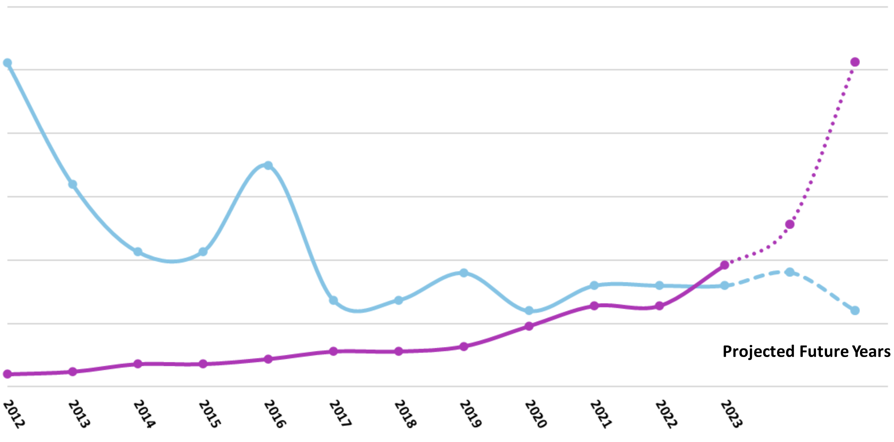
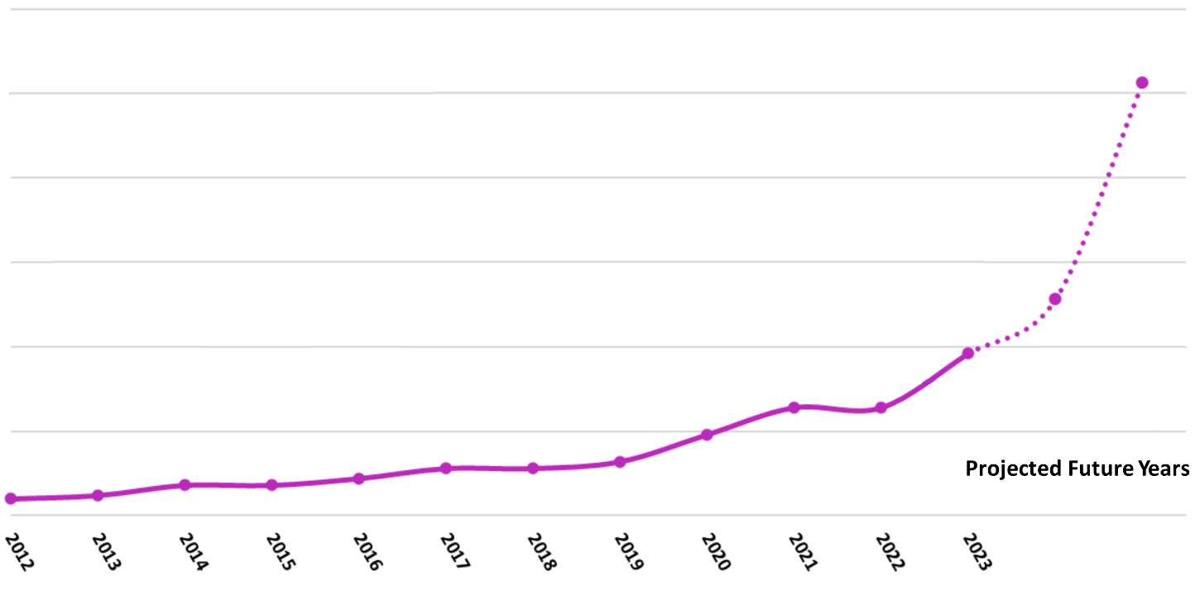

300
120
CPU core count exponentially increasing
250
100
Memory capacity per core decreasing
200
80
CPU Core Count
Memory Capacity per Core (GB)
150
60
100
40
50
20
0
0
2012
2013
2014
2015
2016
2017
2018
2019
2020
2021
2022
2023
2024
2025
Core Count
Memory Capacity per Core
Source: Micron’s Perspective on Impact of CXL on DRAM Bit Growth Rate
Notes:
Let me motivate our work by showing how the CPU core counts change over time. As we can see, CPU core counts are increasing exponentially.
However, on the other hand, if we look at the amount of memory capacity per core, it is decreasing over time because core count is scaling faster than memory capacity.

Slide 4

CXL Enables Memory Capacity Scaling
Higher latency
~200 pins
CXL
Ctrl
^{CPU}
~16 pins
DDR
CXL
Local Memory
CXL Memory
Notes:
One promising solution to this problem is Computer Express Link, or CXL.
Traditionally, memory modules are attached to the CPU through a wide parallel protocol called DDR. However, as a parallel protocol, DDR struggles to scale to larger capacity with limited pins.
In constrast, CXL links allow memory modules to be attached behind CXL memory controllers.
As a serial protocol, CXL can scale memory capacity easier using fewer pins.
The CXL-attached memory can also be accessed using load/store instructions.
However, because CXL is a serial protocol, it has higher access latency.

Slide 5
Higher CXL Latency Can Degrade Workloads
CXL latency (220 ns) ≈ 2x local memory latency (100 ns)
CXL slowdowns workloads by up to 62%
Memory tiering: place data between local and CXL memory
Cloud requirements for CXL include:
Minimal slowdown
Low CPU overhead
Huge page friendly
Das Sharma et al., An Introduction to the Compute Express Link (CXL) Interconnect, CSUR 2024
Notes:
In practice, CXL latency is usually two times higher than the local memory latency.
In our experiments, such high latency slow downs popular cloud workloads by up to 62%. Therefore, to minimize slowdown, we need to place frequently accessed data in local memory while leaving the cold data in CXL memory. Such data placement between local and CXL memory is called memory tiering.
In general-purpose clouds, most workloads are virtualized. There are several requirements to deploy memory tiering with CXL in virtualized environments.
First, we need to ensure minimal slowdown compared to only using local memory. This is especially challenging in cloud environments where multiple virtual machines run on the same host.
Second, memory tiering should have low CPU overhead. Low CPU overhead ensures that most CPU cycles can be used to run customer VMs.
Third, virtualized environments usually use larger page sizes such as 2 MB or 1 GB to reduce the cost of 2-D page table walk. Therefore, memory tiering approach should also be compatible with huge pages.

Slide 6
Combining Software and Hardware for Memory Tiering
Software Tiering
Hardware Tiering
Software + Hardware Tiering
HeMem (SOSP ’21)
TPP (ASPLOS ’23)
MEMTIS (SOSP ’23)
Intel Flat Memory Mode
Intel Flat Memory Mode and
Memstrata
Minimal slowdown
⚠️ High tail slowdown
⚠️ High tail slowdown
✅ Minimal slowdown
Low CPU overhead
❌ High overhead
✅ Low overhead
✅ Low overhead
Huge page friendly
❌ Unfriendly
✅ Friendly
✅ Friendly
Introduced in this work
Notes:
Most prior work on memory tiering focuses on using software to manage data placement. There are many exciting work such as HeMem, TPP, and MEMTIS.
However, as I will show later, since they are not designed for clouds, they can poorly satisfy cloud requirements. For example, they have high tail slowdown, high CPU overhead, and are not huge page friendly.
In this talk, I will first introduce Intel flat memory mode, a hardware-managed memory tiering solution for CXL. Although it still has high tail slowdown, this hardware tiering approach has low CPU overhead and is huge page friendly.
Finally, I will also introduce Memstrata, a lightweight memory allocator for hardware tiering in the hypervisor. I will show that combining hardware tiering with Memstrata satisfies all clouds requirements for memory tiering.
Let me provide some backgrounds on software tiering first.

Slide 7
Prior Work: Software-Managed Memory Tiering
Use hypervisor/OS to identify popular pages and decide page placement
Host Physical Address Space (HPA)
Local Memory
CXL Memory
Guest-to-host page table
Guest Physical Address Space (GPA)
Notes:
Software-managed memory tiering uses the hypervisor or OS to identify popular pages and decide page placement.
With software tiering, the host physical address space has separate ranges for local memory and CXL memory.
The diagram below shows the guest physical address space of one VM.
The hypervisor maps different guest physical pages to either local memory or CXL memory according to their hotness.
The mapping between guest physical address space and host physical address space is defined in the guest-to-host page table, which is also known as EPT for Intel CPUs.
This page table is managed by the hypervisor.

Slide 8
Software Tiering at Odds With Virtualization
Issue 1: High CPU overhead
Instruction sampling (PEBS, IBS) is disabled in clouds
Frequent page table scans incur excessive CPU overhead
Issue 2: Huge page penalty^{[1]}
Virtualization uses larger page sizes (2 MB, 1 GB) to reduce TLB cost
Page Table
...
Map to CXL mem
✅ Lower TLB cost
Hot Data
Larger Pages
PTE (2 MB)
Cold Data
or
...
❌ Coarse data placement
Map to local mem
[1] Calciu et al., Rethinking Software Runtimes for Disaggregated Memory, ASPLOS 2021
Notes:
However, we find that software tiering cannot meet the needs of virtualized environments.
The first issue is the high CPU overhead. Since software is usually not involved in memory accesses, software tiering needs to rely on some hardware features to track memory accesses in order to identify popular pages.
One option is to use instruction sampling such as PEBS or IBS to sample memory instructions. However, they are disabled in clouds due to privacy concerns
The other option is scanning the access bits in page tables. However, to acquire accurate access information, frequent page table scans are required. But they also incurs excessive CPU overhead.
The second issue is the huge page penalty.
Although larger page sizes reduce TLB cost in virtualized environments, they negatively affect software tiering.
For example, this graph shows a page table entry that corresponds to a 2 MB virtual memory page. As shown in previous work and in our experiments, it is likely that this 2MB page has both hot data and cold data.
With software tiering, it can only be mapped to CXL memory, or, mapped to local memory.
There is no way to only place the hot data in local memory while leaving the rest in CXL memory without splitting the page.
Therefore, although larger pages lead to lower TLB cost, they cause the data placement to be more coarse in software tiering.

Slide 9
Introducing Hardware Tiering for CXL
We introduce Intel Flat Memory Mode:
First hardware-managed cacheline-granular memory tiering for CXL
Data placement managed by the CPU memory controller
Zero CPU overhead
Huge page friendly
Available in Intel Xeon 6 Processor
Notes:
To solves these problems, our first contribution is introducing Intel Flat Memory Mode
...
..., which is also known as Granite Rapids

Slide 10
Associativity and Mapping of Intel Flat Memory Mode
Local memory as a direct-mapped, exclusive cache of CXL memory
B
N GB
CXL Memory
Data Placement Managed by CPU Memory Controller
A
N GB
Local Memory
A
B
64B Line
64B Line
Physical Memory Address Space (2N GB)
Notes:
In Intel Flat Memory Mode, the local memory is treated as a direct-mapped, exclusive cache of CXL memory.
Exclusive means that a cacheline is either stored in local memory or CXL memory, but not both.
The capacity between local memory and CXL memory should be 1:1, which is N GB in this graph.
The total amont of physical memory exposed to the software is then 2N GB.
Since local memory is a direct-mapped cache, a given cacheline in the physical memory address space, cacheline A in this case, can only be cached at one location in local memory.
As the capacity ratio between local memory and the total amount of physical memory is 1:2, there will be another cacheline, cacheline B in this case, that is mapped to the same location in local memory as cacheline A.
Only one of them can be cached in local memory. The other one is stored in CXL memory.
The data placement is managed by the CPU memory controller, depending on which cacheline is accessed most recently.

Slide 11
Local Memory Miss in Intel Flat Memory Mode
When a main memory access misses in local memory, the hardware will “swap” the two cache lines
B
N GB
CXL Memory
A
N GB
Local Memory
A
B
Physical Address Space
64B Line
1. Main memory access (e.g., LLC miss)
Notes:
Next, let me show how a local memory miss is handled in Intel flat memory mode.
As shown in the graph, cacheline A is currently cached in local memory. Assume that now there is a main memory access, for example, an LLC miss, on cacheline B.

Slide 12
Local Memory Miss in Intel Flat Memory Mode
When a main memory access misses in local memory, the hardware will “swap” the two cache lines
B
N GB
CXL Memory
A
N GB
Local Memory
2. Read local memory and miss
A
B
Physical Address Space
64B Line
1. Memory access
Notes:
The memory controller will first read from the corresponding location in local memory to check if cacheline B is there.
In this case, it will find that this is a miss.

Slide 13
Local Memory Miss in Intel Flat Memory Mode
When a main memory access misses in local memory, the hardware will “swap” the two cache lines
B
N GB
CXL Memory
3. Read CXL memory
A
N GB
Local Memory
2. Read local memory and miss
A
B
Physical Address Space
64B Line
1. Memory access
Notes:
The memory controller will then read from CXL memory to get the data of cacheline B

Slide 14
Local Memory Miss in Intel Flat Memory Mode
When a main memory access misses in local memory, the hardware will “swap” the two cache lines
A
N GB
CXL Memory
4. “Swap” lines
Serve data
B
N GB
Local Memory
2. Read local memory and miss
A
B
Physical Address Space
64B Line
1. Memory access
Notes:
After fetching the cacheline B from CXL memory, the memory controller will serve the data to the core that requested cacheline B. and, at the same time, swap cacheline A and B between local memory and CXL memory.
After the swap, cacheline B will be cached in local memory instead since it has been recently accessed.

Slide 15

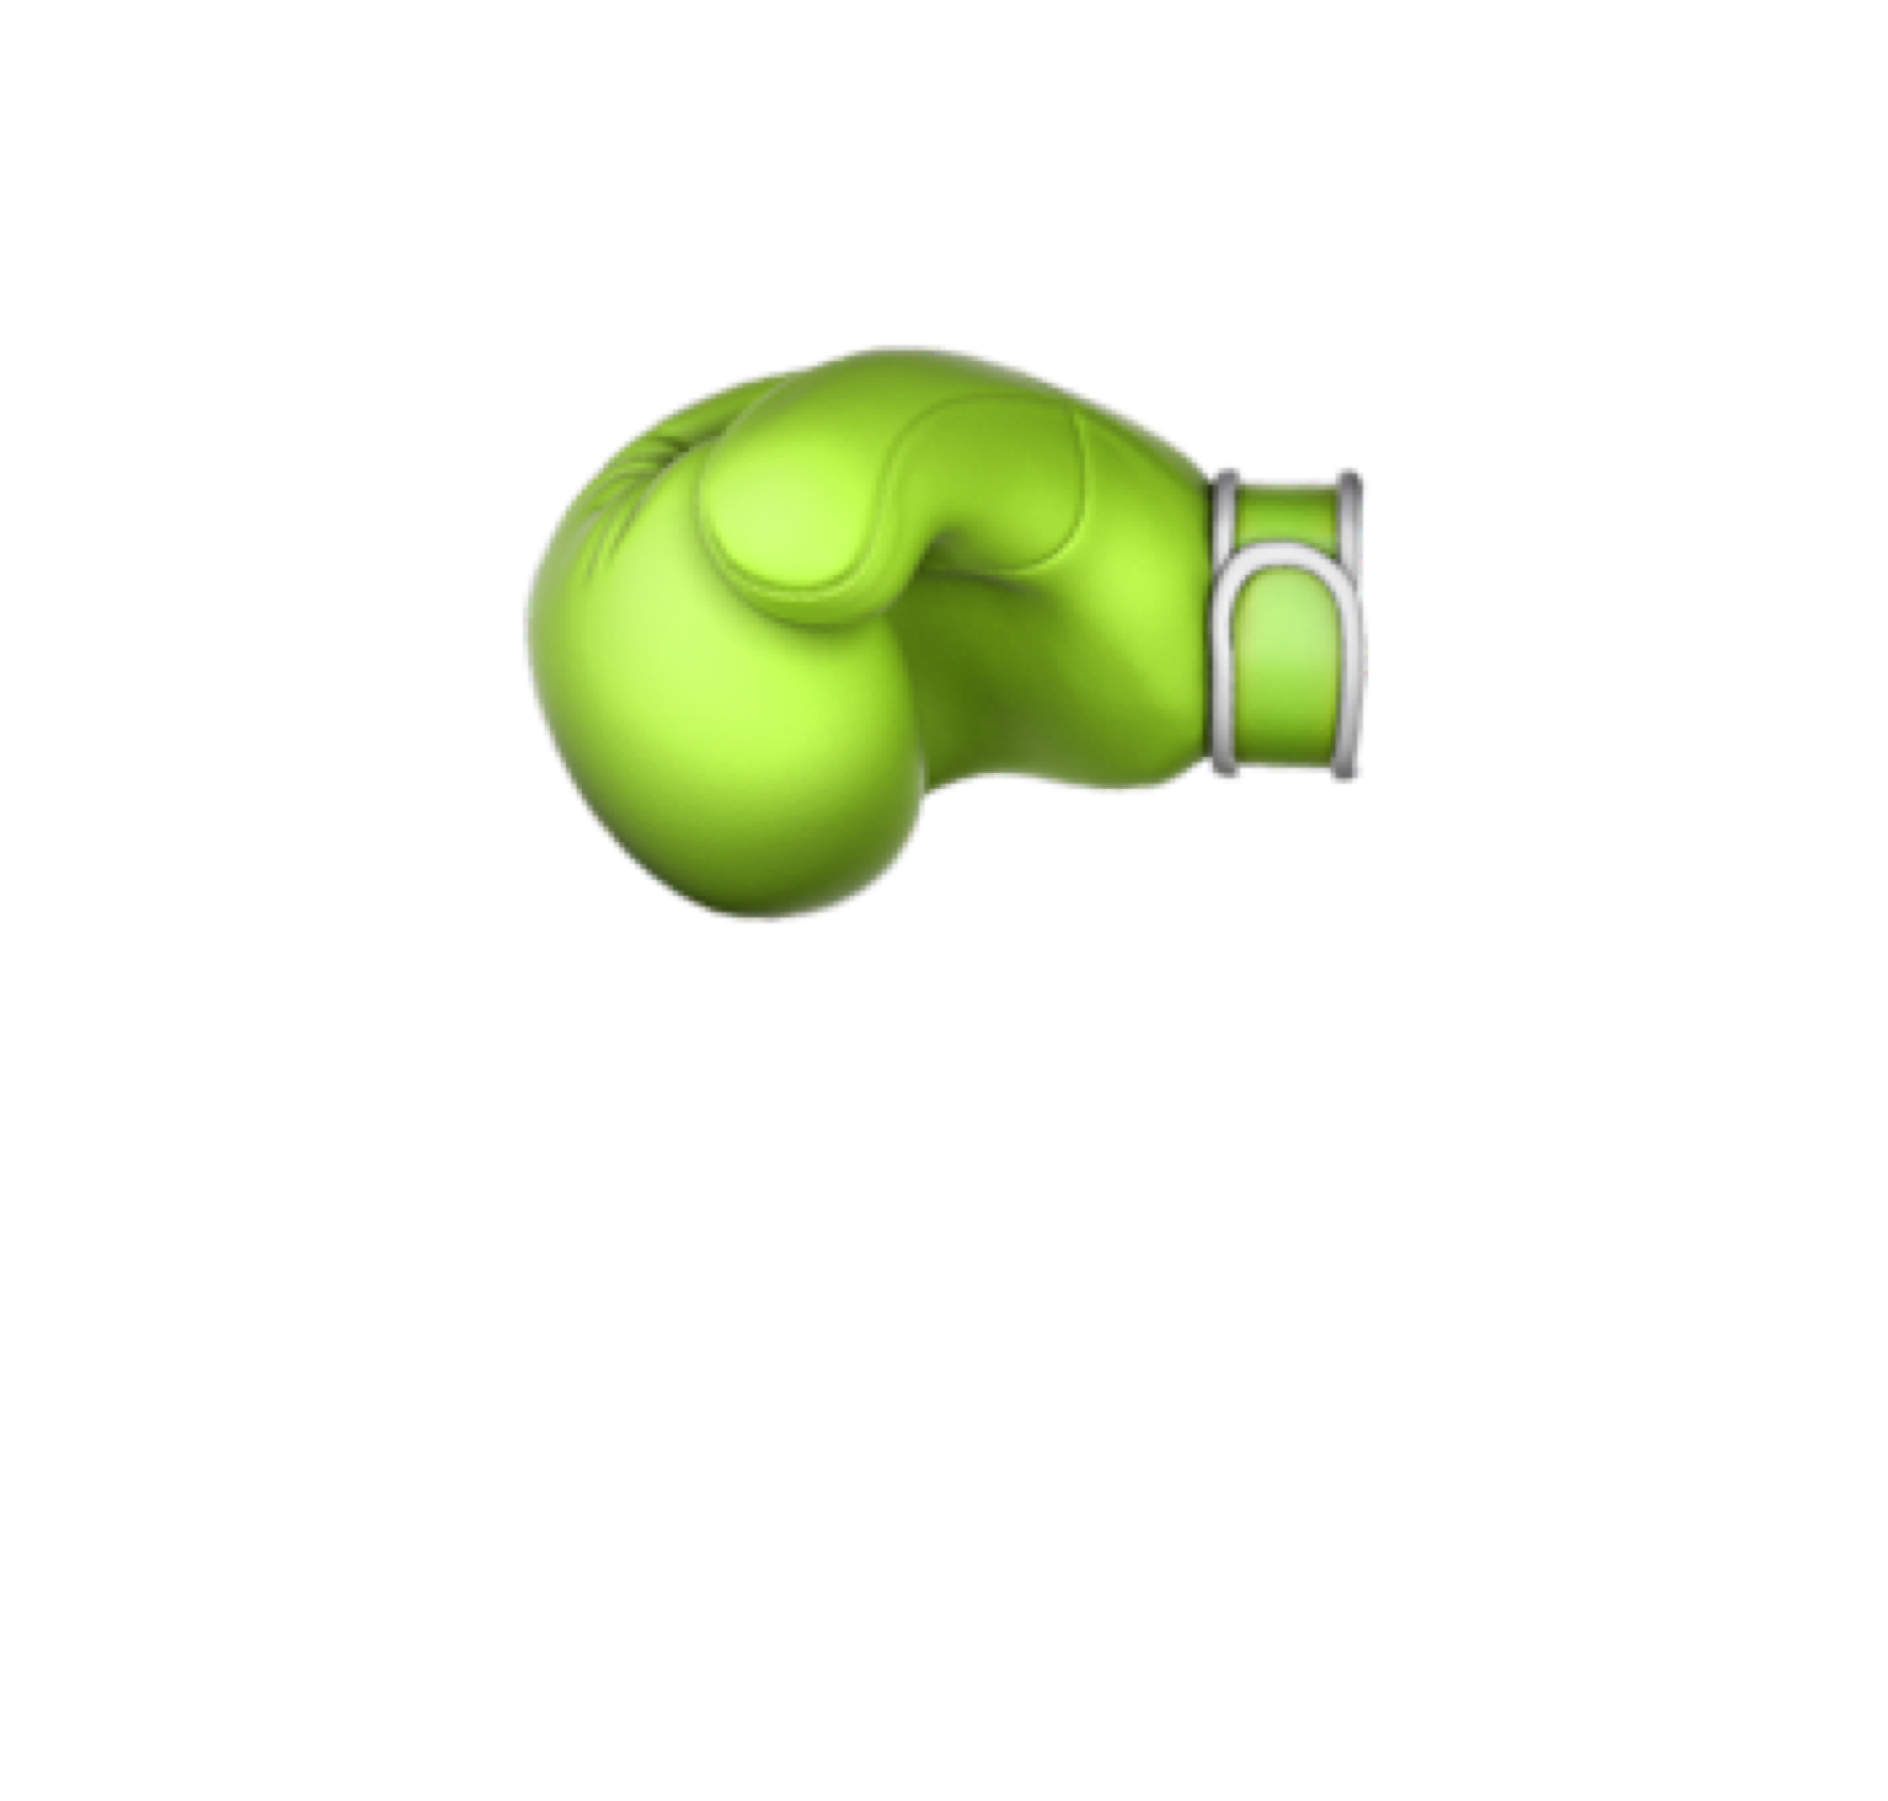
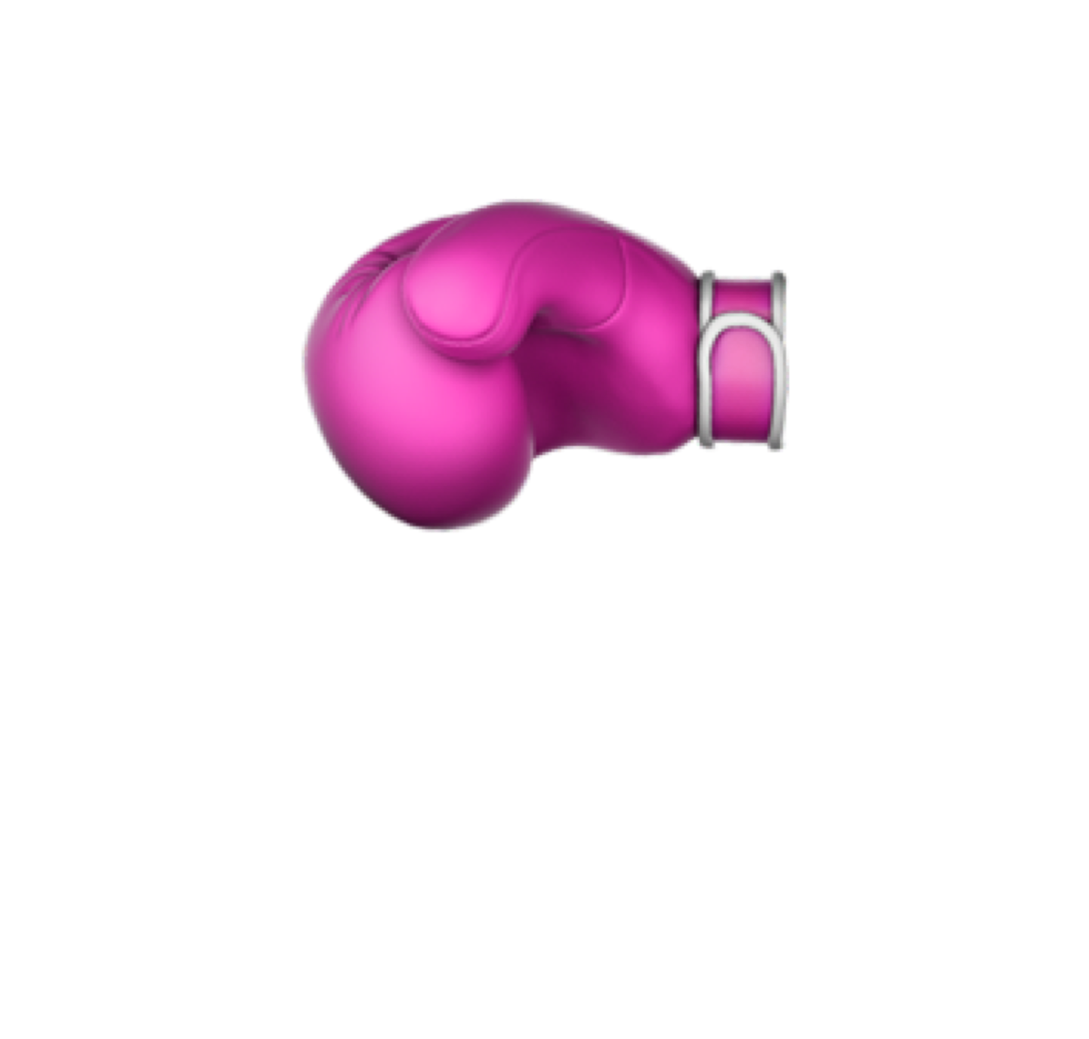

Hardware Tiering Alone Still Has Limitations
Challenge 1: Some workloads have heavy local memory misses
Challenge 2: No performance isolation across VMs
26% workloads have > 5% slowdown (“outlier” workloads)
Local memory contention across VMs
(more than 50% slowdown)
Mapped to same local memory range
VM 1 Memory
VM 2 Memory
Local Memory
Notes:
However, we find that hardware tiering alone still has limitations.
The first challenge is that although hardware tiering attempts to place the most frequently-accessed data in local memory, some workloads still have heavy local memory misses and high slowdown.
We measure the slowdown of both hardware tiering [pause] and software tiering using popular cloud workloads. For software tiering, we use TPP, the state-of-the-art system from Meta.
This graph shows ths CDF of the slowdown compared to only using local memory. The x-axis is the slowdown, and the y-axis is the CDF, where higher is better
When comparing to TPP, HW tiering significantly reduces slowdown.
However, if you look at the tail, there are still 26% of workloads that have more than 5% slowdown with hardware tiering. We call the workloads that have more than 5% slowdown as the outliers.
Those outliers have cache-unfriendly memory access patterns and are sensitive to main memory latency.
Another chanllenge is that, hardware tiering provides no performance isolation across VMs.
For example, let’s say we have two VMs. It’s likely that they are mapped to a common local memory range.
In this case, they will compete for the local memory depending on which VM is more memory intensive.
We find that this local memory contention across VMs can cause more than 50% slowdown.

Slide 16
Adding Dedicated Local Memory for Outliers
Question: How to allocate dedicated local memory across VMs?
B
N GB
CXL Memory
Dedicated Local Memory
A
N GB
Local Memory
M GB
Data always stay in local memory
64B Line
A
B
Host Physical Memory Address Space
(Flat Memory Mode, 2N GB)
Host Physical Address Space
(Dedicated, M GB)
Notes:
To mitigate the performance degradation of outliers, we can increase the amount of local memory by add dedicated local memory besides hardware-tiered memory.
The dedicated local memory is directly exposed to the host physical memory address space.
The data there always stays in local memory.
However, in virtualized environments, the question is, how to allocate dedicated local memory across VMs.

Slide 17
Memstrata: Memory Allocator for Hardware Tiering
A lightweight memory allocator in the hypervisor
Dynamically allocates dedicated memory to eliminate outliers
Provides performance isolation between VMs using page coloring
Memstrata + hardware tiering reduces slowdown from 34% to ~5% across all workloads
Notes:
We introduce...
...
...
...

Slide 18
Memstrata Dynamically Allocates Dedicated Pages
Memstrata
Identify Outliers
Dynamic Page Allocator
Slowdown: 2%
Slowdown: 0%
Slowdown: 15%
VM 1
VM 2
VM 3
HW-Tiered Pages
HW-Tiered Pages
HW-Tiered Pages
Dedicated Pages
Dedicated Pages
Dedicated Pages
Software
Hardware
Hardware-Tiered Memory
Dedicated
Local Memory
Notes:
Let me show how Memstrata allocates dedicated local memory across VMs dynamically.
On the hardware side, hardware-tiered memory and dedicated local memory are exposed as two separate range in the host physical address space to the software.
Let’s say we have 3 VMs running on the host, each with a fixed percentage of HW-tiered pages and dedicated pages.
Different VMs could experience different slowdowns compared to only using local memory because they run different workloads.
For example, ...
In order to mitigate the performance of the outlier. Memstrata will need to first identify the outlier VM.
After identifying the outlier VM, it can then give it more dedicated local memory.

Slide 19
Identifying Outliers in Hypervisor Is Challenging
Challenges:
Hypervisor is unaware of VM workloads
Hardware tiering only provides system-wide local memory miss rate
We build a lightweight prediction model to identify outliers using low-level performance metrics
Per-core metric: L3 miss latency correlates with miss ratio
Notes:
However, identifying outlier VMs in the hypervisor is challenging.
This is because hypervisor is usually unaware of the workloads run inside VMs.
You might think maybe we can measure the local memory miss ratio in each VM as a proxy of the slowdown.
However, hardware tiering only provides a system-wide local memory miss ratio, and cannot report per-VM miss rate.
This is because the data placement is managed by the CPU memory controller, not by individual cores.
To this end, ...
The key thing here is that we can use some per-core performance metrics that correlates well with miss ratio, for example, L3 miss latency.
You can check out the details in the paper.

Slide 20
Memstrata Dynamically Allocates Dedicated Pages
Memstrata
Identify Outliers
Dynamic Page Allocator
Slowdown: 2%
Slowdown: 0%
Slowdown: 15%
VM 1
VM 2
VM 3
HW-Tiered Pages
HW-Tiered Pages
HW-Tiered Pages
Page exchange
Dedicated Pages
Dedicated Pages
Dedicated Pages
Software
Hardware
Hardware-Tiered Memory
Dedicated
Local Memory
Notes:
After identifying the outlier VM, Memstrata will invoke the dynamic page allocator to give the outlier VM more dedicated local memory pages, while moving its HW-tiered pages to other VMs.

Slide 21
Memstrata Dynamically Allocates Dedicated Pages
Memstrata
Identify Outliers
Dynamic Page Allocator
Slowdown: 3%
Slowdown: 2%
Slowdown: 0%
Slowdown: 15%
VM 1
VM 2
VM 3
HW-Tiered Pages
HW-Tiered Pages
HW-Tiered Pages
Page exchange
Dedicated Pages
Dedicated Pages
Software
Hardware
Hardware-Tiered Memory
Dedicated
Local Memory
Notes:
After getting more dedicated local memory, the outlier VM can then recover from the high slowdown.

Slide 22
Evaluate 115 Popular Cloud Workloads
Pre-production Intel Xeon 6 CPU with real CXL cards from Astera Labs
Web
Database
Machine Learning (ML)
Key-Value Store
Spark
Graph Processing
Scientific Compute
115 workloads in total
Notes:
In the evaluation, we use a preproduction Intel Xeon 6 Processor and real CXL cards from Astera Labs.
We evaluate hardware tiering and Memstrata using 115 popular cloud workloads from different categories.

Slide 23
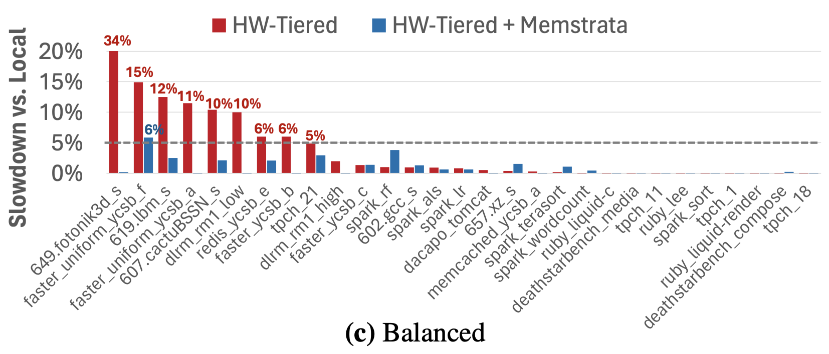

Memstrata Eliminates Outliers With Low CPU Overhead
Sample workloads from representative Azure workload compositions
Continuous VM arrivals and departures
Memstrata mitigates outliers with low CPU overhead (< 3% of a core)
Notes:
To see if Memstrata can eliminate outliers, we ...
Also, in our setting, VMs continuously arrive and departure, representing a realistic cloud scenario.
This graph compares hardware tiering with and without Memstrata in one experiment.
The x-axis shows the workloads used in this experiment, and the y-axis shows the workload slowdown compared to only using local memory. Lower is better in the y-axis.
The red bar represents the slowdown of hardware tiering without Memstrata. As we can see, although many workloads do not have significant slowdowns, there are some outliers with up to 34% slowdown.
The one with the most slowdown is 649 fotonick3d, which is a scientific compute workloads.
The blue bar represents the slowdown of hardware tiering with Memstrata. As shown in the graph, Memstrata is able to reduce the slowdown of all workloads, including the scientific compute outlier, to close to 5%.
In summary, ...
You can check the paper for details and more experiments.

Slide 24

Executive Summary
Background:
CPU core counts scaling faster than memory capacity
CXL enables second-tier memory to facilitate core scaling
But CXL adds latency that hurts performance if not mitigated
Software tiering helps some but is not well suited for public clouds
Contributions:
Intel Flat Memory Mode: First hardware-managed memory tiering for CXL
But still has limitations that slowdown workloads
Memstrata: Memory allocator for hardware tiering to mitigate outliers
Slowdown reduces to 5% vs. unattainable one-tier memory
Source Code
✉️ yz@cs.columbia.edu

Slide 25
Core Count Increasing But DRAM Price Flattening
In clouds, VMs are given at certain core-to-memory ratios (4-32 GB per core)
Memory cost is projected to dominate server cost
Core Count Increasing
DRAM Price Flattening
Source: Micron's Perspective on Impact of CXL on DRAM Bit Growth Rate; https://jcmit.net/memoryprice.htm
Notes:
Let me motivate our work by showing how the core count of general-purpose CPU changes over time. As we can see, the core count of a single CPU socket is increasing rapidly in recent years.
However, on the other hand, although the DRAM price per GB dropped at a log-linear rate before 2012, the DRAM price is flattening recently.
...
...
[question]: the reason behind the trends
[note]
slide 2n: (1 minute), reduce words
memory channel
core proprotyion area of the chip
periherp of the chip
DIMM size

Slide 26
Conclusion
Source Code
Realistic CXL deployment in virtualized environments requires
minimal slowdown
low CPU overhead
huge-page friendly
Neither software tiering nor hardware tiering alone achieves all three goals
We propose a combined software-hardware approach for memory tiering, which satisfies all three requirements
Thank you!
yz@cs.columbia.edu
Notes:
[question] generalize to other hardware solutions, go back to rebuttal
[concise] summary, backup slides
hardware tiering for Arm, direct-swpped caching
contribution: motivation experiment of Memstrata
[question] specific to Intel? work for HBM?
[note] repharse
[question] why higher core count, go to way to reduce total cost of ownership, assert

Slide 27
Evaluate Memstrata in Realistic Settings
Big data, web, and ML workloads dominates cloud workloads [1]
Evaluate Memstrata in different workload compositions with 6 VMs:
Web-heavy: 4 web, 1 data, 1 outlier
Data-heavy: 1 web, 4 data, 1 outlier
Balanced: 2 web, 2 data, 1 others (including ML), 1 outlier
When one workload finishes, start another with the same type
[continuous VM arrival and departure][sample from a distribution]
[1] Wang et al., Designing cloud servers for lower carbon, ISCA 2024
Notes:
6 VMs: hardware prototype (limited capacity)
tighten up the last sentence
When one finish, start another with the same type
local memory setting

Slide 28
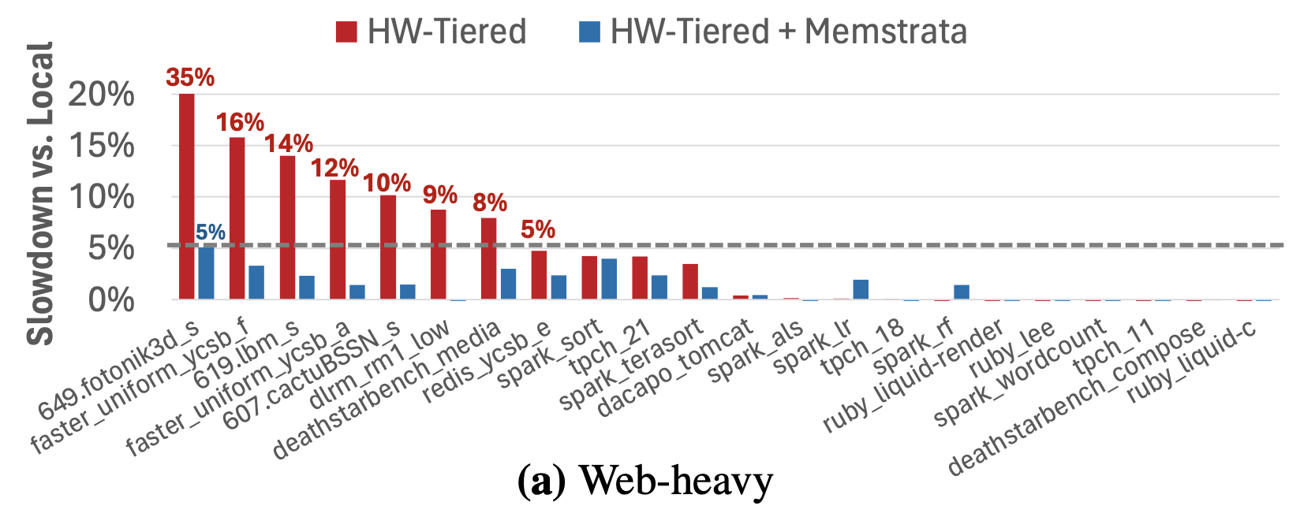
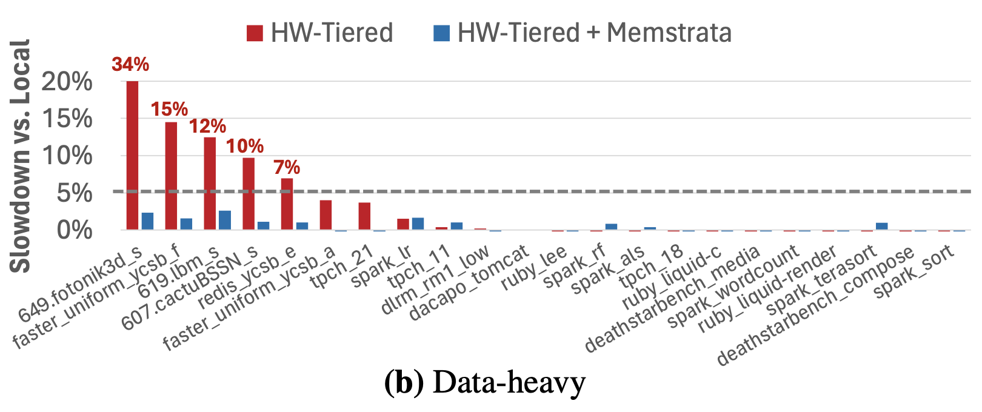
Memstrata Eliminates Outliers With Low CPU Overhead
Memstrata effectively mitigates outliers among all three workload mixes in realistic environments
The max CPU overhead of Memstrata of 3% of a single core
verbally: only show one of them
Notes:
Not SW-HW
6 VM -> so many workloads?? explain
Conclude that point:
Issues with software,
issue with hardware,
combine software and hardware
one fig at a time
eval: target 2 minutes
animation: highlight insights

Slide 29
Dynamically Allocate Dedicated Pages
Memstrata
Identify Outliers
Dynamic Page Allocator
VM 1
VM 2
VM 3
(Outlier)
HW-Tiered Pages
HW-Tiered Pages
...
HW-Tiered Pages
Dedicated Pages
Dedicated Pages
...
Dedicated Pages
Software
Hardware
Hardware-Tiered Memory
Dedicated
Local Memory
Notes:
page exchange
improve page exchange animation
define sensitivity

Slide 30
Evaluate 115 Popular Cloud Workloads
Workload Class | Workloads
Web | Tomcat, Spring, Finagle Chirper, Finagle HTTP, DeathStarBench (Social Network, Media), Ruby YJIT
Database | TPC-C with Silo and TPC-H with Postgres
Machine Learning (ML) | Deep Learning Recommendation (DLRM)
NoSQL KV Store | Redis, Memcached, and FASTER with YCSB
Big Data | Spark with Intel HiBench workloads
Graph Processing | GAP Benchmark
Scientific Compute | SPEC CPU 2017
maybe remove some details, just category
Notes:
Make the visual better
shorten eval, cut
Syncetic -> scientific cmpute
Evaluate 115 Popular Cloud Workloads
lambda/serverless vs. monolithic

Slide 31
Experiment Setup
CPU: pre-production Intel Xeon 6 Processor
Local memory: 128 GB DDR5
CXL memory: 128 GB DDR5 pre-production Astera Labs Leo CXL Smart Memory Controller
Our hardware prototype supports limited memory capacity

Slide 32
Hardware Tiering Alone Still Has Limitations
Challenge 1: Some workloads have heavy local memory misses
Challenge 2: No performance isolation across VMs
Local memory contention across VMs
(more than 50% slowdown)
Mapped to same local memory range
26% workloads have > 5% slowdown
(“outlier” workloads)
VM 1 Memory
VM 2 Memory
🥊👊
Local Memory
Notes:
add TPP here
[question] security concern
[question] gaming: VMs try to get more local memory, oversubscription for power -> game the system
[note] transition here at here

Slide 33
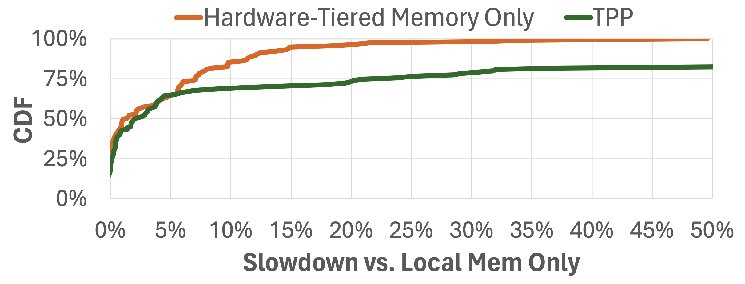
Hardware Tiering vs. Software Tiering
Compare Intel Flat Memory Mode with TPP [1] (state-of-the-art software tiering):
Run each workload in a single VM with 50% local memory and 50% CXL memory
VM memory size is chosen by rounding up the max memory footprint of the workload to VM memory sizes provided by Azure (e.g., 4 GB, 8 GB, 16 GB, 32 GB)
Software tiering has more outliers due to high page migration overhead
[1] Maruf et al., TPP: Transparent Page Placement for CXL-Enabled Tiered-Memory, ASPLOS 2023
Notes:
TPP: Meta
too much text
Move it earlier

Slide 34
Memstrata
Slowdown
Estimator
②
Dynamic Page Allocator
[Outlier: VM 3]
perf_read (VM 1)
...
①
③
exchange_pages(VM 2→VM 3)
perf_read (VM 3)
perf
exchange_pages
Host Kernel
VM 1
VM 2
④
VM 3
HW-Tiered Pages
HW-Tiered Pages
...
HW-Tiered Pages
Dedicated Pages
...
Dedicated Pages
Software
Hardware
Hardware-Tiered Memory
Dedicated
Local Memory
Notes:
[take questions]
illustrate how Memstrata works

Slide 35
Noisy Neighbor Issue
If conflicting pages are allocated to different VMs, those VMs could contend for local memory:
Mix
CXL Memory
Inter-VM conflicts may affect security and performance
Mix
Local Memory
Inter-VM conflicts!
VM 1
VM 2
Physical Memory Address Space
Notes:
evaluate this case, not that interesting

Slide 36
